Slide 1
Production Deployment
Building Transformer-Based Natural Language Processing Applications (Part 3)

Slide 2
FULL COURSE AGENDA
Part 1: Machine Learning in NLP Lecture: NLP background and the role of DNNs leading to the Transformer architecture Lab: Tutorial-style exploration of a translation task using the Transformer architecture
Part 2: Self-Supervision, BERT, and Beyond Lecture: Discussion of how language models with self-supervision have moved beyond the basic Transformer to BERT and ever larger models Lab: Practical hands-on guide to the NVIDIA NeMo API and exercises to build a text classification task and a named entity recognition task using BERT-based language models
Part 3: Production Deployment Lecture: Discussion of production deployment considerations and NVIDIA Triton Inference Server Lab: Hands-on deployment of an example question answering task to NVIDIA Triton

Slide 3
Part 3: Production Deployment
Lecture
Model Selection
Post-Training Optimization
Product Quantization
Knowledge Distillation
Model Code Efficiency
Model Serving
Building the Application
Lab
Exporting the Model
Hosting the Model
Server Performance
Using the Model

Slide 4
Your Network is trained
Notes:
To put it in perspective

Slide 5
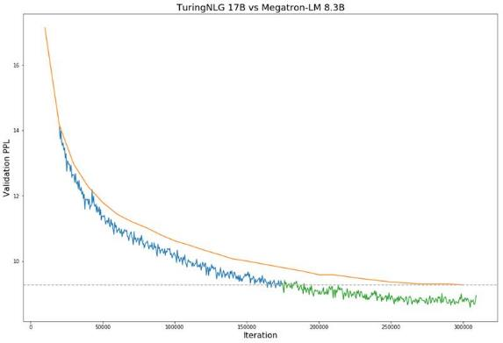
Your network is trained
Now what?
https://www.microsoft.com/en-us/research/blog/turing-nlg-a-17-billion-parameter-language-model-by-microsoft/
Notes:
This is a set of slides explains:
Why Neural Networks did not work in the past but work now
Why majority of interesting problems require scale
The flow:
Neural networks are not new, first theorized in the 1940s, first implementation in the 1950s.
Backpropagation algorithms used to train large modern models existed in the 1980s.
Relatively simple in comparison to many alternative machine learning algorithms
Input data and passes through the neuron by multiplying the data by a set of weights/numbers, adding a set of numbers / biases, and applying a simple non linear function to the result.
Stack the resulting logic up.
Why do we see the progress in translation, self driving cars, natural language processing, and many more only now?
Next slide

Slide 6
Meeting requirements of your business
Notes:
To put it in perspective

Slide 7
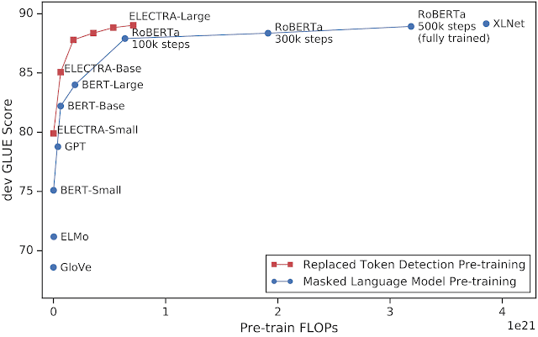
NLP models are large
The Inference cost is high
https://www.microsoft.com/en-us/research/blog/turing-nlg-a-17-billion-parameter-language-model-by-microsoft/
Notes:
This is a set of slides explains:
Why Neural Networks did not work in the past but work now
Why majority of interesting problems require scale
The flow:
Neural networks are not new, first theorized in the 1940s, first implementation in the 1950s.
Backpropagation algorithms used to train large modern models existed in the 1980s.
Relatively simple in comparison to many alternative machine learning algorithms
Input data and passes through the neuron by multiplying the data by a set of weights/numbers, adding a set of numbers / biases, and applying a simple non linear function to the result.
Stack the resulting logic up.
Why do we see the progress in translation, self driving cars, natural language processing, and many more only now?
Next slide

Slide 8
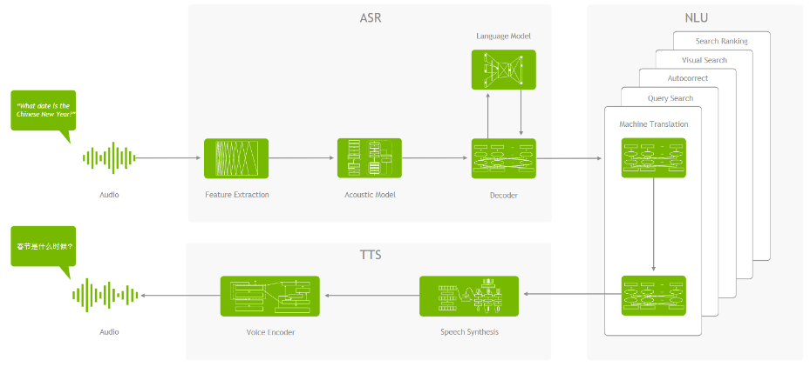
They do not live in isolation
Example of a conversational AI application

Slide 9
They do not live in isolation
Real Time Applications Need to Deliver Latency <300 ms

Slide 10
They do not live in isolation
Real Time Applications Need to Deliver Latency <300 ms

Slide 11
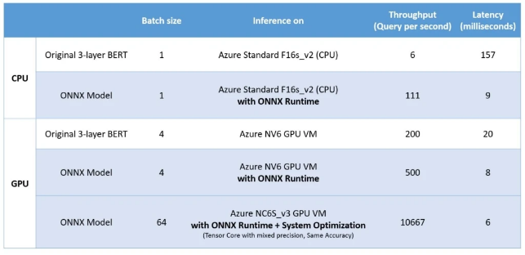
They do not live in isolation
Application bandwidth = Cost
https://cloudblogs.microsoft.com/opensource/2020/01/21/microsoft-onnx-open-source-optimizations-transformer-inference-gpu-cpu/

Slide 12
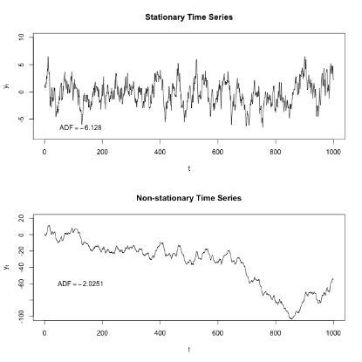
And They need to evolve over time
A lot of processes are not stationary
https://en.wikipedia.org/wiki/Stationary_process

Slide 13
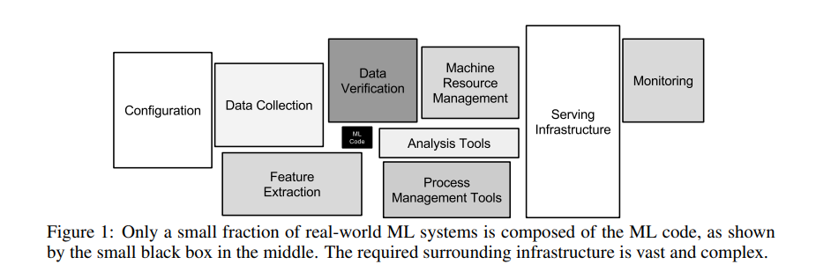
There’s More to an application than just the model
Nonfunctional requirements
Sculley, D., Holt, G., Golovin, D., Davydov, E., Phillips, T., Ebner, D., ... & Dennison, D. (2015). Hidden technical debt in machine learning systems. In Advances in neural information processing systems (pp. 2503-2511).

Slide 14
There’s More to an application than just the model
Nonfunctional requirements
Sculley, D., Holt, G., Golovin, D., Davydov, E., Phillips, T., Ebner, D., ... & Dennison, D. (2015). Hidden technical debt in machine learning systems. In Advances in neural information processing systems (pp. 2503-2511).

Slide 15
Part 3: Production Deployment
Lecture
Model Selection
Post-Training Optimization
Product Quantization
Knowledge Distillation
Model Code Efficiency
Model Serving
Building the Application
Lab
Exporting the Model
Hosting the Model
Server Performance
Using the Model

Slide 16
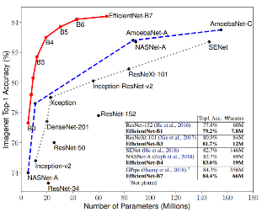
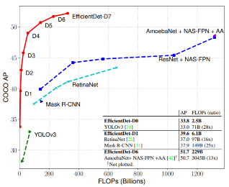
Model Selection
Not all models are created equally
NLP
Image Classification
Object detection

Slide 17
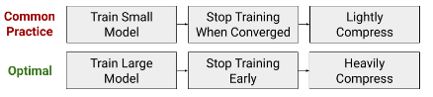
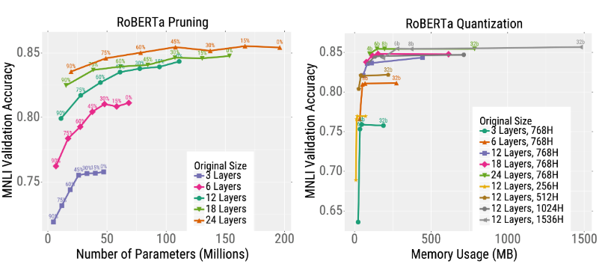
Model Selection
Not all models respond in the same way to knowledge distillation, pruning and quantization
https://bair.berkeley.edu/blog/2020/03/05/compress/
Li, Z., Wallace, E., Shen, S., Lin, K., Keutzer, K., Klein, D., & Gonzalez, J. E. (2020). Train large, then compress: Rethinking model size for efficient training and inference of transformers. arXiv preprint arXiv:2002.11794.

Slide 18
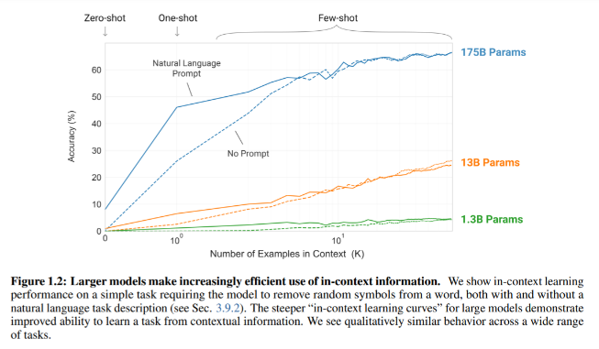
Model Selection
And very large models are and will continue to be prevalent in NLP
Brown, T. B., Mann, B., Ryder, N., Subbiah, M., Kaplan, J., Dhariwal, P., ... & Agarwal, S. (2020). Language Models are Few-Shot Learners. arXiv preprint arXiv:2005.14165.

Slide 19
Direct implications
Notes:
To put it in perspective

Slide 20
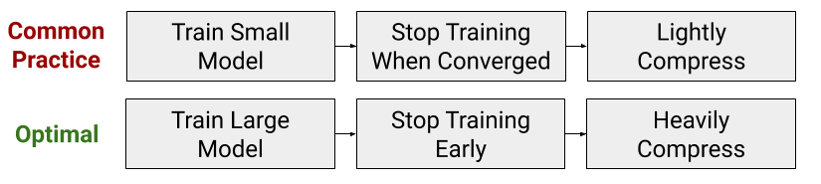
Increasing importance of Pruning and quantization
E.g. Train Large then compress
https://bair.berkeley.edu/blog/2020/03/05/compress/
Li, Z., Wallace, E., Shen, S., Lin, K., Keutzer, K., Klein, D., & Gonzalez, J. E. (2020). Train large, then compress: Rethinking model size for efficient training and inference of transformers. arXiv preprint arXiv:2002.11794.

Slide 21







Increasing importance of Pruning and quantization
Hardware acceleration for reduced precision arithmetic and sparsity
1250
20X
310
155
625
10X
Relative Compute
625
20
310
8
16
125
60
V100
FP64
A100
FP64
V100
FP32
A100
TF32
A100
SPARSE TF32
V100
FP16
A100
FP16
A100
SPARSE FP16
V100
INT8
A100
INT8
A100
SPARSE
INT8

Slide 22
Part 3: Production Deployment
Lecture
Model Selection
Post-Training Optimization
Product Quantization
Knowledge Distillation
Model Code Efficiency
Model Serving
Building the Application
Lab
Exporting the Model
Hosting the Model
Server Performance
Using the Model

Slide 23
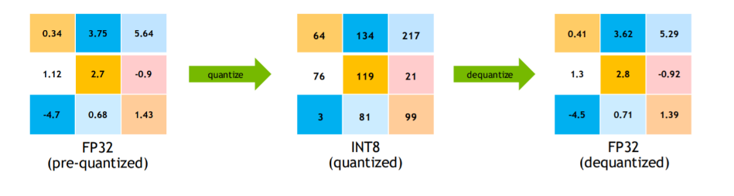
Quantization
The idea

Slide 24
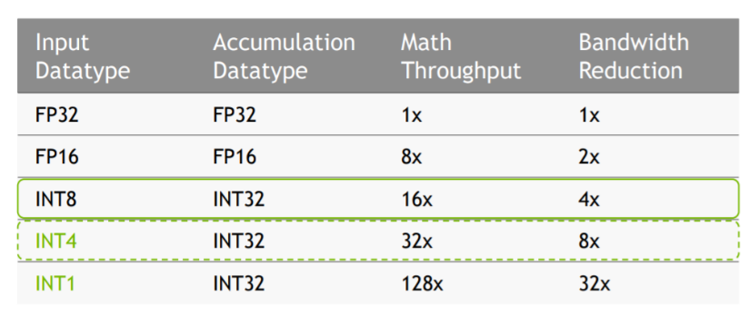
Quantization
The rationale

Slide 25
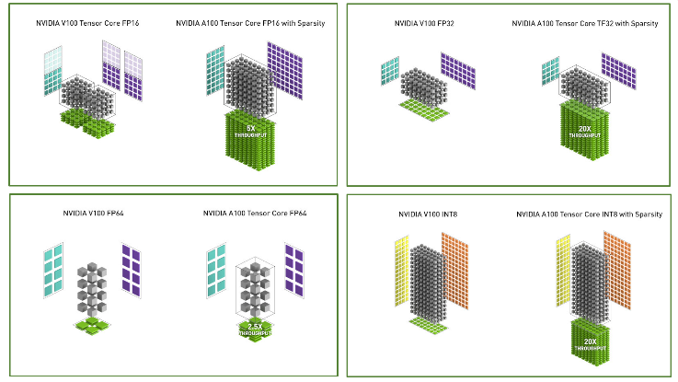
Quantization
The rationale

Slide 26
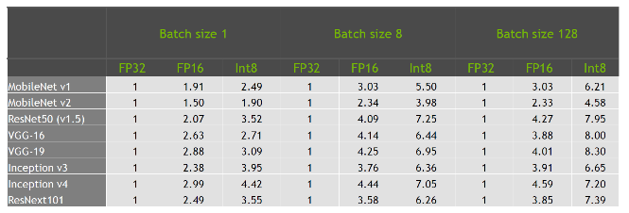
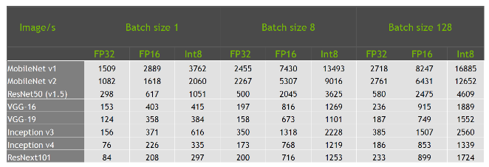
Quantization
The results (speedup and throughput)
TensorRT optimized models executed on Tesla T4, input size 224x224 for all apart from the Inception networks for which the input size was 299x299

Slide 27
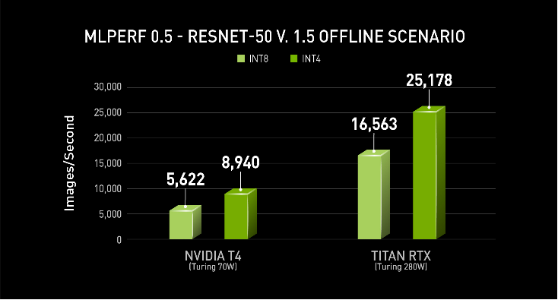
Quantization
Beyond INT8
INT4 quantization for resnet50
"Int4 Precision for AI Inference"

Slide 28
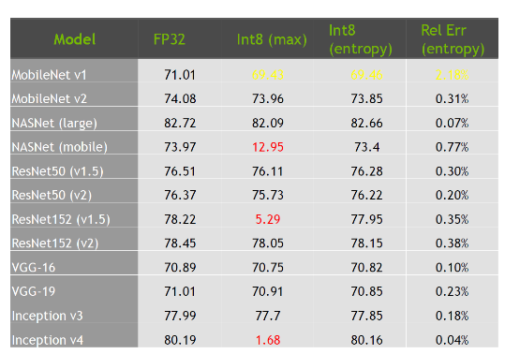
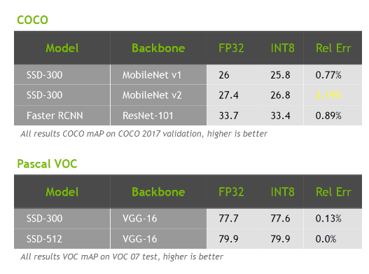
Impact on accuracy
In a wide range of cases minimal

Slide 29
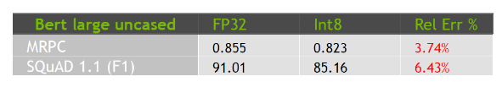
Impact of model design
Not all neural network mechanisms quantize well

Slide 30
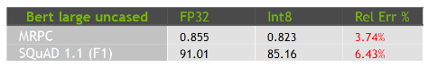
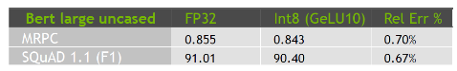
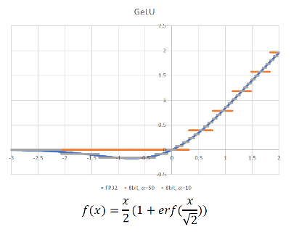
Impact of model design
Model alterations required
GeLU produces highly asymmetric range
Negative values between [-0.17,0]
All negative values clipped to 0
GeLU10 allows to maintain negative values

Slide 31
Loss of accuracy
Reasons
Outlier in the tensor:
Example: BERT, Inception V4
Solution: Clip. Tighten the range, use bits more efficiently
Not enough precision in quantized representation
Example: Int8 for MobileNet V1
Example: Int4 for Resnet50
Solution: Train/fine tune for quantization

Slide 32
Learn more
GTC Talks
S9659: Inference at Reduced Precision on GPUs
S21664: Toward INT8 Inference: Deploying Quantization-Aware Trained Networks using TensorRT

Slide 33
Quantization Tools
Notes:
To put it in perspective

Slide 34
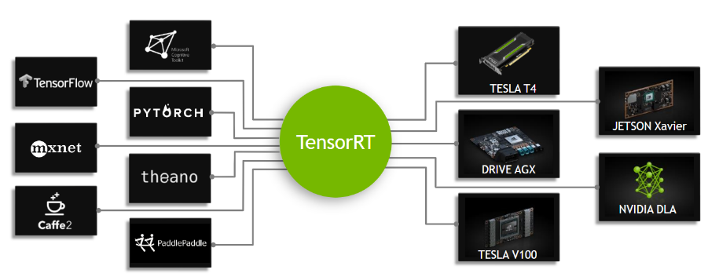
NVIDIA TENSORRT
From Every Framework, Optimized For Each Target Platform
Notes:
Quantized INT8 (Precision Optimization)
Significantly improves (~ triples actually) inference performance of models trained in FP32 full precision by quantizing them to INT8, while minimizing accuracy loss
Layer Fusion (Graph Optimization)
Improves GPU utilization and optimizes memory storage and bandwidth by combining successive nodes into a single node, for single kernel execution
Kernel Auto-Tuning (Auto-tuning)
Optimizes execution time by choosing the best data layer and best parallel algorithms for the target Jetson, Tesla or DrivePX GPU platform
Dynamic Tensor Memory (Memory optimization)
Reduces memory footprint and improves memory re-use by allocating memory for each tensor only for the duration it’s usage
Multi Stream Execution
Scales to multiple input streams, by processing them parallel using the same model and weights

Slide 35
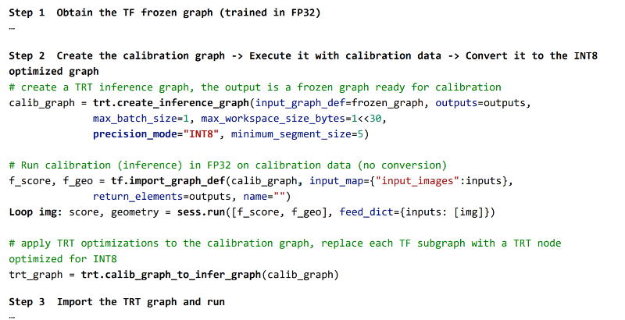
INT8 Quantization example
TF-TRT
https://docs.nvidia.com/deeplearning/dgx/tf-trt-user-guide/index.html

Slide 36
Pruning

Slide 37
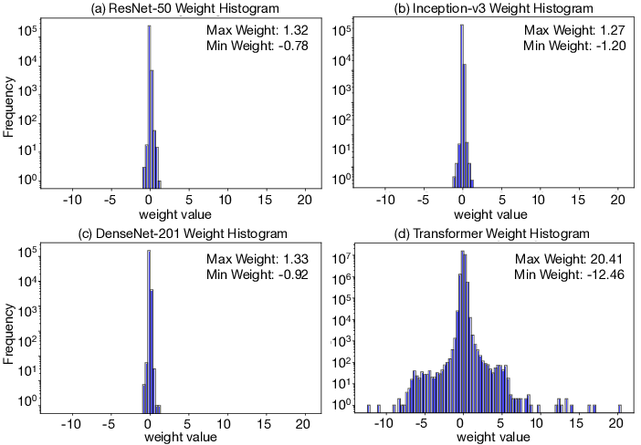
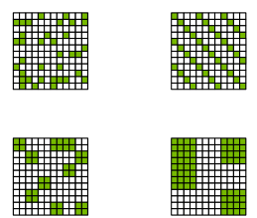
Pruning
The idea
The opportunity:
Reduced memory bandwidth
Reduced memory footprint
Acceleration (especially in presence of hardware acceleration)
Tambe, T., Yang, E. Y., Wan, Z., Deng, Y., Reddi, V. J., Rush, A., ... & Wei, G. Y. (2019). AdaptivFloat: A Floating-point based Data Type for Resilient Deep Learning Inference. arXiv preprint arXiv:1909.13271.

Slide 38
Difficult to get to work reliably

Slide 39
Structured Sparsity

Slide 40
Sparsity in A100 gpu
Fine-grained structured sparsity for Tensor Cores
50% fine-grained sparsity
2:4 pattern: 2 values out of each contiguous block of 4 must be 0
Addresses the 3 challenges:
Accuracy: maintains accuracy of the original, unpruned network
Medium sparsity level (50%), fine-grained
Training: a recipe shown to work across tasks and networks
Speedup:
Specialized Tensor Core support for sparse math
Structured: lends itself to efficient memory utilization
2:4 structured-sparse matrix
= zero value

Slide 41
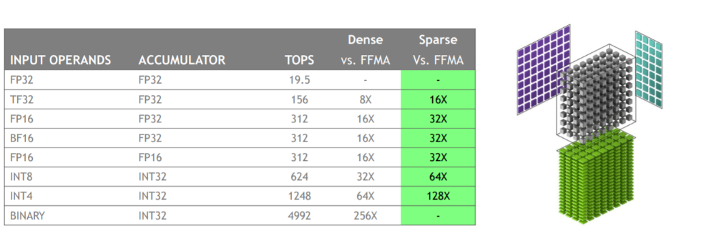
Pruning
Structured sparsity

Slide 42
Reliable approach

Slide 43
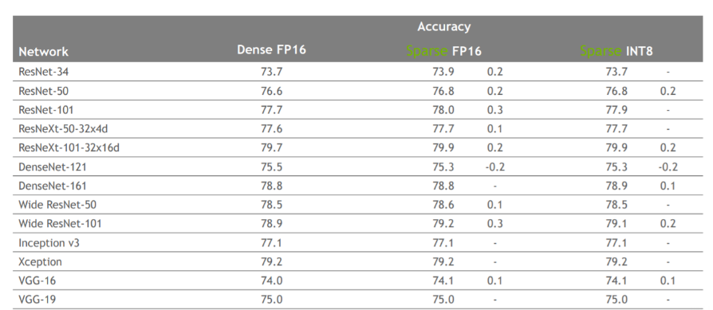
Pruning
Model performance

Slide 44
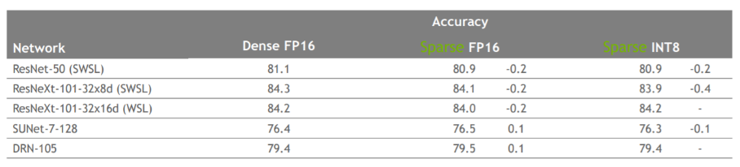
Pruning
Model performance

Slide 45
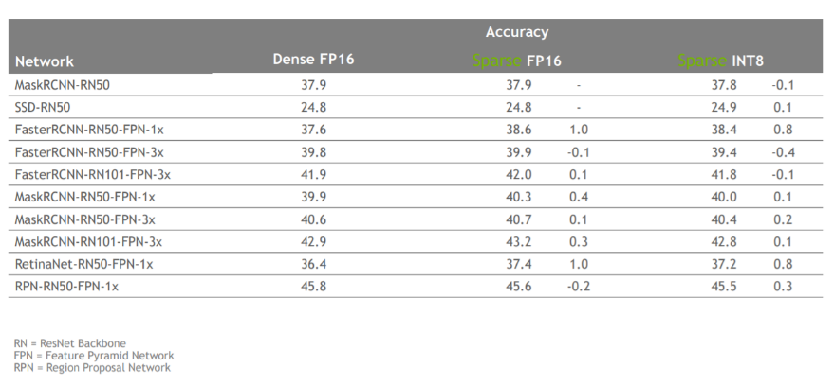
Pruning
Model performance

Slide 46
Impact on NLP

Slide 47
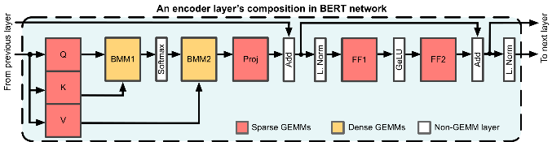
Network Performance
BERT-Large
1.8x GEMM Performance -> 1.5x Network Performance
Some operations remain dense:
Non-GEMM layers (Softmax, Residual add, Normalization, Activation functions, …)
GEMMs without weights to be pruned – Attention Batched Matrix Multiplies

Slide 48
Training Recipe

Slide 49
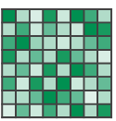
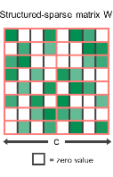
Recipe for 2:4 sparse network training
Dense weights
1) Train (or obtain) a dense network
2) Prune for 2:4 sparsity
3) Repeat the original training procedure
Same hyper-parameters as in step-1
Initialize to weights from step-2
Maintain the 0 pattern from step-2: no need to recompute the mask
2) Prune for 2:4 sparsity
1) Train (or obtain) a dense network
2:4 sparse weights
Retrained 2:4 sparse weights

Slide 50
Example learning rate schedule
Dense Training
Sparse Retraining
Learning Rate
Step 1
Step 2
Step 3

Slide 51
Bert squad example
SQuAD Dataset and fine-tuning is too small to compensate for pruning on its own
Phase 1:
Pretrain language model
Phase2:
Finetune for SQuAD
Phase 1:
Pretrain language model
Phase 1: Sparse
Pretrain language model
Phase2: Sparse
Finetune for SQuAD
Learning Rate
Learning Rate
Step 1
Step 2
Step 3

Slide 52
APEX: Automatic Sparsity

Slide 53
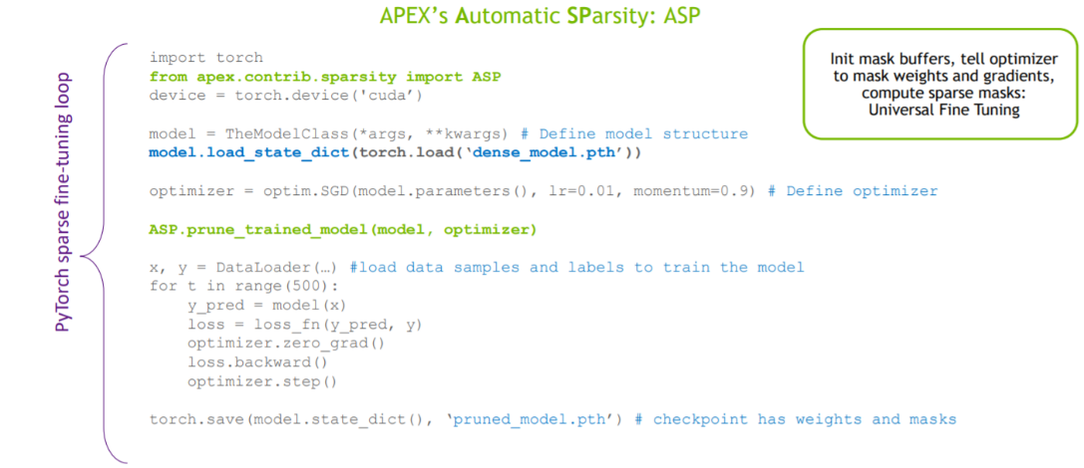
Taking advantage of Structured Sparsity

Slide 54
Part 3: Production Deployment
Lecture
Model Selection
Post-Training Optimization
Product Quantization
Knowledge Distillation
Model Code Efficiency
Model Serving
Building the Application
Lab
Exporting the Model
Hosting the Model
Server Performance
Using the Model

Slide 55
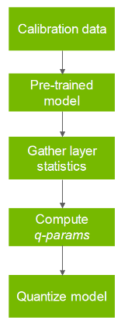
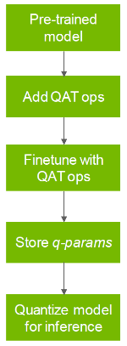
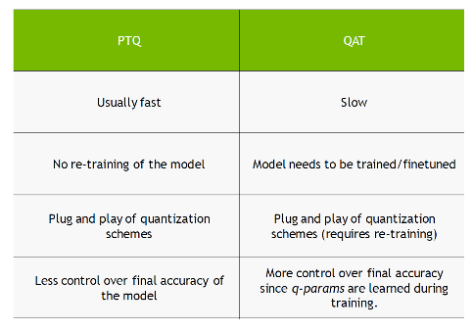
Quantization
Approaches
Post-training quantization(PTQ)
Quantization-aware training (QAT)

Slide 56
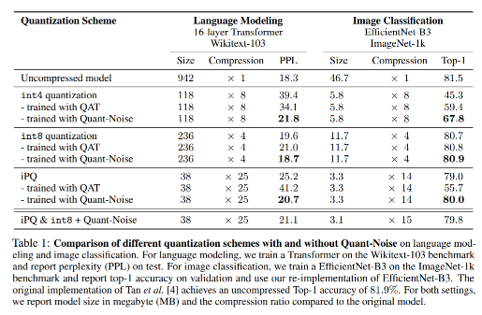
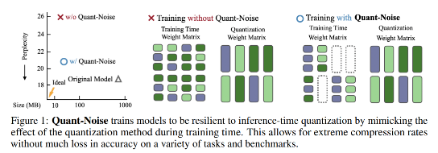
Extreme model compression
Training with quantization noise
Polino, A., Pascanu, R., & Alistarh, D. (2018). Model compression via distillation and quantization. arXiv preprint arXiv:1802.05668.

Slide 57
“We used Quant-Noise to compress Facebook AI’s state-of-the-art RoBERTa Base model from 480 MB to 14 MB while achieving 82.5 percent on MNLI, compared with 84.8 percent for the original model.”

Slide 58
Part 3: Production Deployment
Lecture
Model Selection
Post-Training Optimization
Product Quantization
Knowledge Distillation
Model Code Efficiency
Model Serving
Building the Application
Lab
Exporting the Model
Hosting the Model
Server Performance
Using the Model

Slide 59
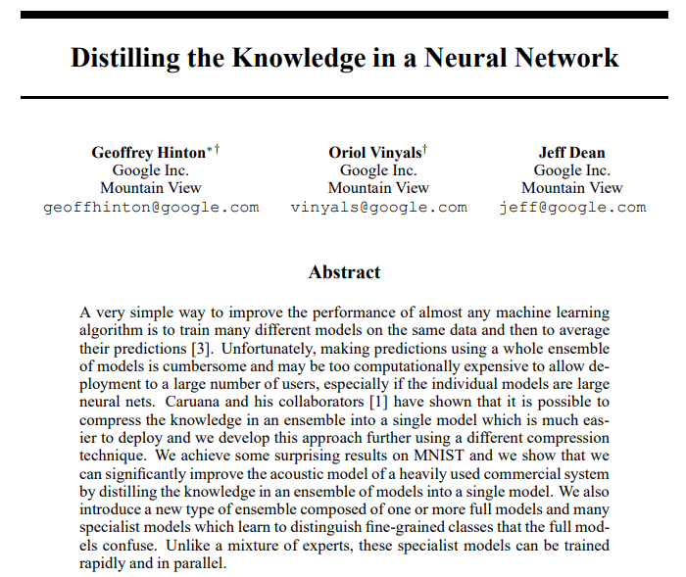
Knowledge Distillation
The idea

Slide 60
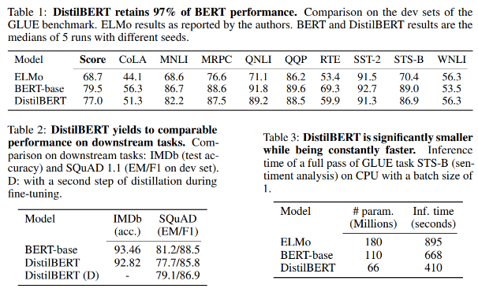
Knowledge Distillation
DistillBERT
Sanh, V., Debut, L., Chaumond, J., & Wolf, T. (2019). DistilBERT, a distilled version of BERT: smaller, faster, cheaper and lighter. arXiv preprint arXiv:1910.01108.

Slide 61
Part 3: Production Deployment
Lecture
Model Selection
Post-Training Optimization
Product Quantization
Knowledge Distillation
Model Code Efficiency
Model Serving
Building the Application
Lab
Exporting the Model
Hosting the Model
Server Performance
Using the Model

Slide 62
Not All models have the same code quality

Slide 63
Compute matters
But so does code quality
Monthly DL Framework Updates & Optimizations Drive Performance
ResNet-50 v1.5 Training | 8x V100 | DGX-1

Slide 64


NGC: GPU-optimized Software Hub
Simplifying DL, ML and HPC Workflows
Model Training Scripts
NLP, Image Classification,
Object Detection & more
NGC
Containers
DL, ML, HPC
Helm Charts
AI applications, K8s cluster, Registry
Pre-trained Models
NLP, Classification, Object Detection & more
Industry SDKs
Medical Imaging, Intelligent Video Analytics

Slide 65
Pretrained models & model scripts
Build AI Solutions Faster
PRE-TRAINED MODELS
Deploy AI quickly with models for industry specific use cases
Covers everything from speech to object detection
Integrate into existing workflows with code samples
Easily use transfer learning to adapt to your bespoke use case
MODEL SCRIPTS
Reference neural network architectures across all domains and popular frameworks with latest SOTA
Jupyter notebook starter kits
Healthcare (~30 models) | BioBERT (NLP), Clara (Computer Vision)
Manufacturing (~25 Models) | Object Detection, Image Classification
Retail (~25 models) | BERT, Transformer
70 TensorRT Plans | Classification/Segmentation for v5, v6, v7
Natural Language Processing | 25 Bert Configurations
Recommendation Engines | Neural Collaborative Filtering, VAE
Speech | Jasper, Tacotron, WaveGlow
Translation | GNMT

Slide 66
This applies not only to training but inference as well

Slide 67
Code quality is key
Dramatic differences in model performance
3-layer BERT with 128 sequence length
https://cloudblogs.microsoft.com/opensource/2020/01/21/microsoft-onnx-open-source-optimizations-transformer-inference-gpu-cpu

Slide 68
OPTIMIzING inference with TensorRT

Slide 69
NVIDIA TENSORRT
From Every Framework, Optimized For Each Target Platform
Notes:
Quantized INT8 (Precision Optimization)
Significantly improves (~ triples actually) inference performance of models trained in FP32 full precision by quantizing them to INT8, while minimizing accuracy loss
Layer Fusion (Graph Optimization)
Improves GPU utilization and optimizes memory storage and bandwidth by combining successive nodes into a single node, for single kernel execution
Kernel Auto-Tuning (Auto-tuning)
Optimizes execution time by choosing the best data layer and best parallel algorithms for the target Jetson, Tesla or DrivePX GPU platform
Dynamic Tensor Memory (Memory optimization)
Reduces memory footprint and improves memory re-use by allocating memory for each tensor only for the duration it’s usage
Multi Stream Execution
Scales to multiple input streams, by processing them parallel using the same model and weights

Slide 70
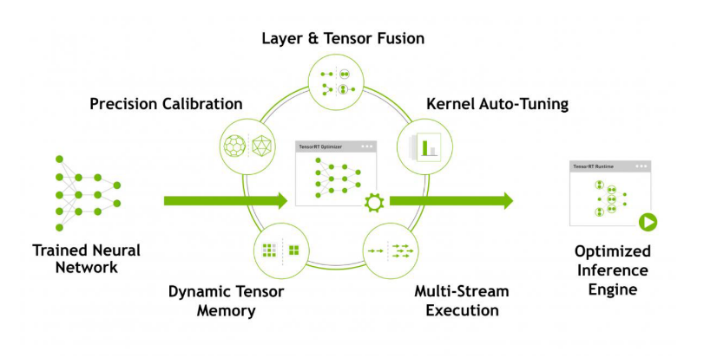
TensorRT
Optimizations
developer.nvidia.com/tensorrt

Slide 71







TensorRT ONNX PARSER
High-Performance Inference for ONNX Models
Optimize and deploy models from ONNX-supported frameworks to production
Apply TensorRT optimizations to any ONNX framework (Caffe 2, Microsoft Cognitive Toolkit, MxNet & PyTorch)
Import TensorFlow and Keras through converters (tf2onnx, keras2onnx)
Use with C++ and Python apps
20+ New Ops in TensorRT 7
Support for Opset 11 (See List of Supported Ops)
developer.nvidia.com/tensorrt
Notes:
Will have python and C++ bindings for ONNX parser in TRT 4. Much easier than C++ API. Might have done an ONNX parser demo. Leon Goldgeisser is engineer. Also people in the frameworks team might be familiar (Ben Barstell).
Should find out what sample. Resnet50 parser with ONNX. We will run TRT on all models in ONNX model zoo.

Slide 72
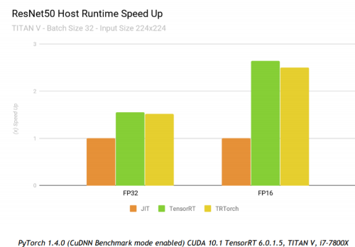
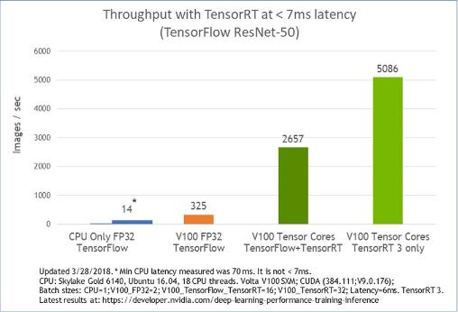
TensorRT
Tight integration with DL frameworks
Pytorch -> TRTorch
TensorFlow -> TF-TRT

Slide 73

















Widely Adopted
Accelerating most demanding applications

Slide 74
Impact on NLP

Slide 75
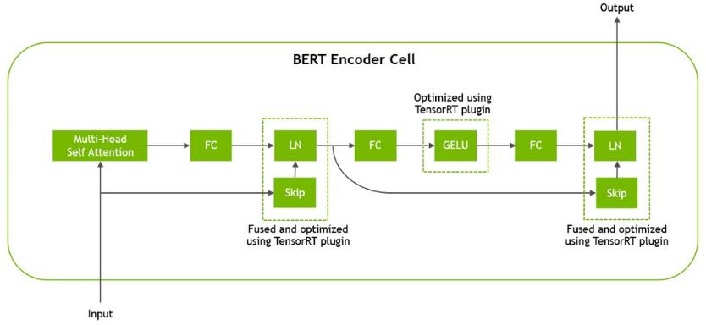
TensorRT
BERT Encoder optimizations

Slide 76
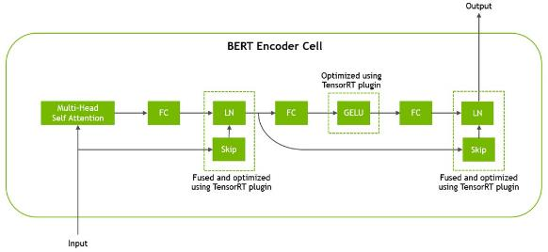
Custom plugins
Optimized GeLU as well as skip and layer-normalization operations
Naïve implementation would require a large number of TensorRT elementary layers
For k layers, the naïve implementation would require k-1 memory roundtrips
The skip and layer-normalization(LN) layers occur twice per Transformer layer and are fused in a single kernel
gelu(x) = a * x * (1 + tanh( b * (x + c * x^3) ))
Result = x^3
Result = c * Result
Result = x + Result
Result = b * Result
Result = tanh(Result)
Result = x * Result
Result = a * Result

Slide 77
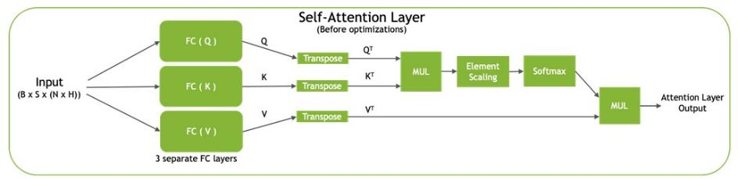
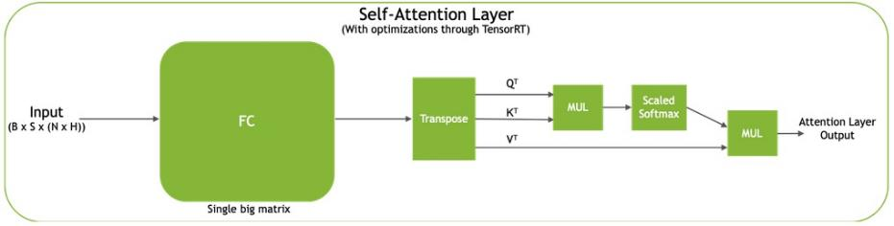
Custom plugins
Self-attention layer

Slide 78

Implications
Significant impact on latency and throughput (batch 1)
Using a Tesla T4 GPU, BERT optimized with TensorRT can perform inference in 2.2 ms for a QA task similar to available in SQuAD with batch size =1 and sequence length = 128.

Slide 79

Implications
Significant impact on latency and throughput

Slide 80
Beyond BERT

Slide 81
Faster Transformer
Designed for training and inference speed
Encoder:
1.5x compare to TensorFlow with XLA on FP16
Decoder on NVIDIA Tesla T4
2.5x speedup for batch size 1 (online translating scheme)
2x speedup for large batch size in FP16
Decoding on NVIDIA Tesla T4
7x speedup for batch size 1 and beam width 4 (online translating scheme)
2x speedup for large batch size in FP16.
Decoding on NVIDIA Tesla V100
6x speedup for batch size 1 and beam width 4 (online translating scheme)
3x speedup for large batch size in FP16.
https://github.com/NVIDIA/DeepLearningExamples/tree/master/FasterTransformer#feature-support-matrix

Slide 82
Consider using TensorRT

Slide 83
Part 3: Production Deployment
Lecture
Model Selection
Post-Training Optimization
Product Quantization
Knowledge Distillation
Model Code Efficiency
Model Serving
Building the Application
Lab
Exporting the Model
Hosting the Model
Server Performance
Using the Model

Slide 84




INEFFICIENCY LIMITS INNOVATION
Difficulties with deploying data center inference
Single Model Only
Single Framework Only
Custom Development
!
ASR
NLP
Rec- ommender
Some systems are overused while others are underutilized
Solutions can only support models from one framework
Developers need to reinvent the plumbing for every application

Slide 85






NVIDIA TRITON INFERENCE SERVER
Production data center inference server
Maximize real-time inference performance of GPUs
Quickly deploy and manage multiple models per GPU per node
Easily scale to heterogeneous GPUs and multi GPU nodes
Integrates with orchestration systems and auto-scalers via latency and health metrics
Now open source for thorough customization and integration
Triton Inference Server
NVIDIA T4
NVIDIA T4
Triton Inference Server
Tesla V100
Tesla V100
Triton Inference Server
Tesla P4
Tesla P4

Slide 86





FEATURES
Concurrent Model Execution Multiple models (or multiple instances of same model) may execute on GPU simultaneously
CPU Model Inference Execution
Framework native models can execute inference requests on the CPU
Metrics
Utilization, count, memory, and latency
Custom Backend
Custom backend allows the user more flexibility by providing their own implementation of an execution engine through the use of a shared library
Model Ensemble
Pipeline of one or more models and the connection of input and output tensors between those models (can be used with custom backend)
Dynamic Batching Inference requests can be batched up by the inference server to 1) the model-allowed maximum or 2) the user-defined latency SLA
Multiple Model Format Support PyTorch JIT (.pt)
TensorFlow GraphDef/SavedModel TensorFlow and TensorRT GraphDef
ONNX graph (ONNX Runtime) TensorRT Plans Caffe2 NetDef (ONNX import path)
CMake build Build the inference server from source making it more portable to multiple OSes and removing the build dependency on Docker
Streaming API
Built-in support for audio streaming input e.g. for speech recognition

Slide 87

DYNAMIC BATCHING SCHEDULER
Triton Inference Server
Framework Backend
Runtime
Batch-1 Request
Batch-4 Request
Context
Dynamic Batcher
Context

Slide 88
DYNAMIC BATCHING SCHEDULER
Triton Inference Server
Grouping requests into a single “batch” increases overall GPU throughput
ModelY Backend
Runtime
Context
Dynamic Batcher
Context
Preferred batch size and wait time are configuration options.
Assume 4 gives best utilization in this example.

Slide 89

DYNAMIC BATCHING
2.5X Faster Inferences/Second at a 50ms End-to-End Server Latency Threshold
Triton Inference Server groups inference requests based on customer defined metrics for optimal performance
Customer defines 1) batch size (required) and 2) latency requirements (optional)
Example: No dynamic batching (batch size 1 & 8) vs dynamic batching

Slide 90

CONCURRENT MODEL EXECUTION - RESNET 50
6x Better Performance and Improved GPU Utilization Through Multiple Model Concurrency
Triton Inference Server
Common Scenario 1
One API using multiple copies of the same model on a GPU
Example: 8 instances of TRT FP16 ResNet50 (each model takes 2 GB GPU memory) are loaded onto the GPU and can run concurrently on a 16GB T4 GPU.
10 concurrent inference requests happen: each model instance fulfills one request simultaneously and 2 are queued in the per-model scheduler queues in Triton Inference Server to execute after the 8 requests finish. With this configuration, 2680 inferences per second at 152 ms with batch size 8 on each inference server instance is achieved.
T4 16GB GPU
10 concurrent requests
Inference Requests
RN50 Instance 1
ResNet50
Request Queue
CUDA Stream
RN50 Instance 2
CUDA Stream
RN50 Instance 3
CUDA Stream
RN50 Instance 4
CUDA Stream
RN50 Instance 5
CUDA Stream
RN50 Instance 6
CUDA Stream
RN50 Instance 7
CUDA Stream
RN50 Instance 8
CUDA Stream
Time

Slide 91

CONCURRENT MODEL EXECUTION - RESNET 50
6x Better Performance and Improved GPU Utilization Through Multiple Model Concurrency
Common Scenario 1
One API using multiple copies of the same model on a GPU
Example: 8 instances of TRT FP16 ResNet50 (each model takes 2 GB GPU memory) are loaded onto the GPU and can run concurrently on a 16GB T4 GPU.
10 concurrent inference requests happen: each model instance fulfills one request simultaneously and 2 are queued in the per-model scheduler queues in Triton Inference Server to execute after the 8 requests finish. With this configuration, 2680 inferences per second at 152 ms with batch size 8 on each inference server instance is achieved.

Slide 92
CONCURRENT MODEL EXECUTION RESNET 50 & DEEP RECOMMENDER
Triton Inference Server
Common Scenario 2
Many APIs using multiple different models on a GPU
Example: 4 instances of TRT FP16 ResNet50 and 4 instances of TRT FP16 Deep Recommender are running concurrently on one GPU. Ten requests come in for both models at the same time (5 for each model) and fed to the appropriate model for inference. The requests are fulfilled concurrently and sent back to the user. One request is queued for each model.
With this configuration, 5778 inferences per second at 80 ms with batch size 8 on each inference server instance is achieved.
T4 16GB GPU
Resnet50
Request Queue
RN50 Instance 1
5 concurrent requests
CUDA Stream
RN50 Instance 2
CUDA Stream
RN50 Instance 3
Inference Requests
CUDA Stream
RN50 Instance 4
CUDA Stream
5 concurrent requests
DeepRec Instance 1
Deep Rec
Request Queue
CUDA Stream
DeepRec Instance 2
CUDA Stream
DeepRec Instance 3
CUDA Stream
DeepRec Instance 4
CUDA Stream
Time

Slide 93


CONCURRENT MODEL EXECUTION RESNET 50 & DEEP RECOMMENDER
Common Scenario 2
Many APIs using multiple different models on a GPU
Example: 4 instances of TRT FP16 ResNet50 and 4 instances of TRT FP16 Deep Recommender are running concurrently on one GPU. Ten requests come in for both models at the same time (5 for each model) and fed to the appropriate model for inference. The requests are fulfilled concurrently and sent back to the user. One request is queued for each model.
With this configuration, 5778 inferences per second at 80 ms with batch size 8 on each inference server instance is achieved.
Notes:
ResNet50 TRT on V100 FP 16 16GB Batch Size 8 Model Concurrency 4 1909 infer/sec, latency 33456 usec
Deep Recommender TRT om V100 FP16 16GB Batch Size 8 Model COncurrency 4 5000 inf/sec, latency 19211 usec
Write each instance is 2GB
10 requests, 8 happen at the same time, 2 happen after
Derive how long 12 requests will take at same time = 0.001 seconds
BS 8 on each instance
4 instances of TRT FP16 Resnet50 and 4 instances of TRT FP16 Deep Recommender are running concurrently on on GPU. Ten requests come in for both models at the same time (5 for each model) and fed to the appropriate model for inference. The requests are fulfilled concurrently and sent back to the user. One request is queued for each model. With this configuration, 6909 inferences per second at 53 ms with batch size 8 on each inference server instance is achieved.

Slide 94


TRITON INFERENCE SERVER METRICS FOR AUTOSCALING
Before Triton Inference Server - 800 FPS
Before Triton Inference Server - 5,000 FPS
One model per GPU
Requests are steady across all models
Utilization is low on all GPUs
Spike in requests for blue model
GPUs running blue model are being fully utilized
Other GPUs remain underutilized

Slide 95


TRITON INFERENCE SERVER METRICS FOR AUTOSCALING
After Triton Inference Server - 5,000 FPS
After Triton Inference Server - 15,000 FPS
Load multiple models on every GPU
Load is evenly distributed between all GPUs
Spike in requests for blue model
Each GPU can run the blue model concurrently
Metrics to indicate time to scale up
GPU utilization
Power usage
Inference count
Queue time
Number of requests/sec

Slide 96
STREAMING INFERENCE REQUESTS
Corr 1
Corr 1
Corr 1
Corr 1
Corr 2
Corr 2
Corr 3
Corr 3
Inference Request
NEW
Per Model Request Queues
DeepSpeech2 Sequence Batcher
New Streaming API
Based on the correlation ID, the audio requests are sent to the appropriate batch slot in the sequence batcher*
DeepSpeech2
Corr 2
Corr 2
Corr 3
Corr 3
Corr 2
Corr 2
Corr 3
Corr 3
Wave2Letter
Framework
Inference Backend
NEW
Wav2Letter Sequence Batcher
Corr 1
Corr 1
Corr 1
Corr 1
Corr 1
Corr 1
Corr 1
Corr 1
*Correct order of requests is assumed at entry into the endpoint
Note: Corr = Correlation ID

Slide 97

MODEL ENSEMBLING
Pipeline of one or more models and the connection of input and output tensors between those models
Use for model stitching or data flow of multiple models such as data preprocessing → inference → data post-processing
Collects the output tensors in each step, provides them as input tensors for other steps according to the specification
Ensemble models will inherit the characteristics of the models involved, so the meta-data in the request header must comply with the models within the ensemble
Notes:
When an inference request for the ensemble model is received, the ensemble scheduler will:
1) Recognize that the “IMAGE” tensor in the request is mapped to input “RAW_IMAGE” in the preprocess model.
2) Check models within the ensemble and send an internal request to the preprocess model because all the input tensors required are ready.
3) Recognize the completion of the internal request, collect the output tensor and map the content to “preprocessed_image” which is an unique name known within the ensemble.
4) Map the newly collected tensor to inputs of the models within the ensemble. In this case, the inputs of “classification_model” and “segmentation_model” will be mapped and marked as ready.
5) Check models that require the newly collected tensor and send internal requests to models whose inputs are ready, the classification model and the segmentation model in this case. Note that the responses will be in arbitrary order depending on the load and computation time of individual models.
6) Repeat step 3-5 until no more internal requests should be sent, and then response to the inference request with the tensors mapped to the ensemble output names.

Slide 98


perf_client TOOL
Measures throughput (inf/s) and latency under varying client loads
perf_client Modes
Specify how many concurrent outstanding requests and it will find a stable latency and throughput for that level
Generate throughput vs latency curve by increasing the request concurrency until a specific latency or concurrency limit is reached
Generates a file containing CSV output of the results
Easy steps to help visualize the throughput vs latency tradeoffs

Slide 99

ALL CPU WORKLOADS SUPPORTED
Deploy the CPU workloads used today and benefit from Triton Inference Server features (TRT not required)
Triton relies on framework backends (Tensorflow, Caffe2, PyTorch) to execute the inference request on CPU
Support for Tensorflow and Caffe2 CPU optimizations using Intel MKL-DNN library
Allows frameworks backends to make use of multiple CPUs and cores Benefit from Triton features:
Multiple Model Framework Support
Dynamic batching
Custom backend
Model Ensembling
Audio Streaming API
Notes:
Model concurrency: you just indicate how many instances of the model you want to be available for concurrent execution. For CPU the concurrent model instances are run on multiple CPUs
(depending on the framework each instance may itself use multiple CPUs).
CPU uses threads and a model might need multiple threads, TF executer spons the threads necessary depending on how many each instance needs
With batching, it works pretty much the same as on GPU. A larger batch on CPU will be a larger operation for the model, and will therefore take longer. It’s important to make sure all CPUs are busy (enough threads/models to fill CPUs) before implementing batching.
Pulling from TF (most popular framework)

Slide 100


TRITON INFERENCE SERVER COLLABORATION WITH KUBEFLOW
What is Kubeflow?
Open-source project to make ML workflows on Kubernetes simple, portable, and scalable
Customizable scripts and configuration files to deploy containers on their chosen environment
Problems it solves
Easily set up an ML stack/pipeline that can fit into the majority of enterprise datacenter and multi-cloud environments
How it helps Triton Inference Server
Triton Inference Server is deployed as a component inside of a production workflow to
Optimize GPU performance
Enable auto-scaling, traffic load balancing, and redundancy/failover via metrics
For a more detailed explanation and step-by-step guidance for this collaboration, refer to this GitHub repo.

Slide 101

Triton Inference Server Helm Chart
Simple helm chart for installing a single instance of the NVIDIA Triton Inference Server
Helm: Most used “package manager” for Kubernetes
We built a simple chart (“package”) for the Triton Inference Server.
You can use it to easily deploy an instance of the server. It can also be easily configured to point to a different image, model store, …
https://github.com/NVIDIA/tensorrt-inference-server/tree/b6b45ead074d57e3d18703b7c0273672c5e92893/deploy/single_server

Slide 102
Part 3: Production Deployment
Lecture
Model Selection
Post-Training Optimization
Product Quantization
Knowledge Distillation
Model Code Efficiency
Model Serving
Building the Application
Lab
Exporting the Model
Hosting the Model
Server Performance
Using the Model

Slide 103
Application != Single Model
Notes:
To put it in perspective

Slide 104
















The application
Typically composed of many components
ASR
NLU
Language Model
Search Ranking
Visual Search
Autocorrect
“What date is the
Chinese New Year?”
Query Search
Machine Translation
Audio
Feature Extraction
Acoustic Model
Decoder
TTS
Audio
Voice Encoder
Speech Synthesis
Notes:
However, building such conv AI models is difficult for the following reasons:
1. Multiple modules needs to be joined to build a conversational AI model.
2. Mixing and matching, manipulating and experimenting to get the best performance is hard.
So how is NVIDIA working will help to solve this problem ? Through NeMo.

Slide 105
JARVIS

Slide 106

Nvidia JARVIS
Fully Accelerated Framework for Multimodal Conversational AI Services
Jarvis
RETRAIN
Dialog Manager
Transfer Learning
Multi-Speaker Transcription
Chatbot
Gesture Recognition
Look to Talk
video
NeMo
NLU
audio
Vision
Speech
Service Maker
Multi-Speaker
Transcription
NVIDIA GPU CLOUD
NVIDIA AI TOOLKIT
End-to-End Multimodal Conversational AI Services​
Pre-trained SOTA models-100,000 Hours of DGX ​
Retrain with NeMo​
Interactive Response – 150ms on A100 versus 25sec on CPU​
Deploy Services with One Line of Code​
TRITON INFERENCE SERVER
Sign up for Early Access
https://developer.nvidia.com/nvidia-jarvis
Notes:
Build, train and deploy GPU-accelerated AI systems.
Enables multi-modal fusion such as gestures and gaze along with speech in context.
Enables simultaneous multi-user, multi-context conversations with AI agent.
NeMo integration for training and fine-tuning models.
TensorRT integration for high throughput and low latency deep learning inference.
One click deployment using Helm charts to create Jarvis AI services.

Slide 107

PRETRAINED MODELS AND AI TOOLKIT
Train SOTA Models on Your Data to Understand your Domain and Jargon
100+ pretrained models in NGC
SOTA models trained over 100,000 hours on NVIDIA DGX™
Retrain for your domain using NeMo & Transfer Learning Toolkit
Deploy trained models to real-time services using Helm charts
Notes:
NeMo stack has several components for rapid building of Conversational AI applications:
Core Modules – NeMo module is a block of python code that takes input types and produce output types. Nemo has over 80 core modules that helps to quickly mix and match to create a conversational AI model.
Neural Types: Neural Types are used to check input tensors to make sure that two neural modules are compatible and catch semantic and dimensionality errors.
Data Layer: Ready to use data layer APIs to load the dataset for training.
NeMo Collections: Rapid building of conversational AI applications for ASR, NLP and TTS using pretrained models available.
Pre-trained models: Many pre-trained models trained with multiple large corpus are available in NGC.

Slide 108

MULTIMODAL SKILLS
Use speech and vision for natural interaction
Build new skills by fusing services for ASR, NLU, TTS, and CV
Reference skills include:
Multi-speaker transcription
Chatbot
Look-to-talk
Dialog manager manages multi-user and multi-context scenarios
Multimodal application with multiple users and contexts
Notes:
NeMo stack has several components for rapid building of Conversational AI applications:
Core Modules – NeMo module is a block of python code that takes input types and produce output types. Nemo has over 80 core modules that helps to quickly mix and match to create a conversational AI model.
Neural Types: Neural Types are used to check input tensors to make sure that two neural modules are compatible and catch semantic and dimensionality errors.
Data Layer: Ready to use data layer APIs to load the dataset for training.
NeMo Collections: Rapid building of conversational AI applications for ASR, NLP and TTS using pretrained models available.
Pre-trained models: Many pre-trained models trained with multiple large corpus are available in NGC.

Slide 109

BUILD CONVERSATIONAL AI SERVICES
Optimized Services for Real Time Applications
Jarvis
Build applications easily by connecting performance tuned services
Task specific services include:
ASR
Intent Classification
Slot Filling
Pose Estimation
Facial Landmark Detection
Services for streaming & batch usage
Build new services from any model in ONNX format
Access services for gRPC and HTTP endpoints
Dialog Manager
Dialog Manager
Jarvis Client Applications
Jarvis Services
ASR
Intent
...
TTS
Jarvis AI services
https://ngc.nvidia.com/catalog/model-scripts/nvidia:jasper_for_trtis
Notes:
Jarvis ASR service steps without using helm charts from Server side.
Download NGC containers/models
Preprocess custom dataset and train model
Export/Generate Pytorch/TorchScript/ONNX files
Generate TRTIS repository (TRT6 is generated behind the scenes)
Launch TRTIs container.
Launch Jarvis API server with asr=true
Call API in client application
Available pretrained models for Jarvis: 1. Standard streaming recognition model.
2. Streaming recognition with voice activity detection - Use for long streams
3. Offline recognition with voice activity detection.
4. Offline recognition without voice activity detection.

Slide 110

Deploy Models AS Real-Time Services
One Click to Create High-Performance Services from SOTA Models
Deploy models to services in the cloud, data center, and at the edge
Single command to set up and run the entire Jarvis application through Helm charts on Kubernetes cluster
Customization of Helm charts for your setup and use case.
JARVIS SERVICES
NLU
Vision
Speech
One click deployment
TensorRT
Triton Inference Server
Jarvis API Server
Language
Model
Decoder
Acoustic Model
Feature Extraction
NLU &
Recommenders
Speech Synthesis
Voice Encoder
Helm command to deploy models to production
https://ngc.nvidia.com/helm-charts/ea-jarvis:jarvis-api
Notes:
In real-time conversational AI applications, more than 30 models are involved in the pipeline. Helm charts automates all the deployment process.
Steps to deploy Jarvis service using Helm charts:
1. Download the Helm chart from NGC using the following command.
export NGC_API_KEY=<your ngc key>
helm fetch https://helm.ngc.nvidia.com/ea-jarvis/charts/jarvis-api-0.1-
ea.tgz --username=\$oauthtoken --password=$NGC_API_KEY –untar
2. The above commands creates a Jarvis-api folder in the current directory.
3. Modify values.yaml files in the directory according to the custom model requirements such as disabling any of the conv AI service, replication count for handling the system failure, removing pre-built models etc..
4. Deploy the chart using helm install Jarvis-api
Deployment pre-requisite steps:
The helm deployment uses two Kubernetes secrets for obtaining access to NGC: one for Docker images, and another for model artifacts. By default, these are named Jarvis-ea-
regcred and jarvis-ngc-read, respectively. The names of the secrets can be modified in the values.yaml file.
Configure Jarvis-ea-regcred and Jarvis-ngc of the secrets with the following commands respectively:
kubectl create secret generic jarvis-ea-regcred --fromfile=.dockerconfigjson=$HOME/.docker/config.json --type=kubernetes.io/dockerconfigjson
kubectl create secret generic jarvis-ngc-read --from-literal=key=$NGC_API_KEY

Slide 111



Jarvis Samples
Visual Diarization
Look To Talk
Virtual Assistant
Transcribe multi-user multi-context conversations
Wait for gaze before triggering AI assistant
End-to-end conversational AI system
Notes:
Visual Diarization
Handles multi-contextual conversations with Face detection and lip activity.
Sensor fusion technology for supporting the multiuser and multi context conversations.
Face detection to understand the context
Lip activity to determine who is speaking
Transcribe the audio
Label transcriptions per individual speaker.
gRPC endpoints for direct interaction with the inference models.
Look To Talk
No wakeup word required to trigger the AI assistant
Sensor fusion technology for automatically triggering the AI assistant
Gaze detection to understand user engagement
Transcribe the audio
Label transcriptions per individual speaker.
gRPC endpoints for direct interaction with the inference models.
________________________________________________________________________________________________________________________________________________________
Look to talk uses gaze to identify where the user is looking at. Once use case is started after the Jarvis configuration setup
1. you will see a text render at the top corner which says Conversation: Inactive.
2. After the user looks at the camera and subsequently “activates” the look to talk use case, you will see the text and color change to Conversation: Active.
3. Now, the user is expected to talk to the assistant and when they do so, a boxed frame will surround the speaker’s face during the conversation as well as the ASR transcription on the bottom of the screen.
4. If there is a valid response from the Jarvis assistant, you will hear text-tospeech on the speaker
You can also improve the model accuracy via fine tuning with NeMo
Deploy via docker containers from NGC into Kubernetes(EGX).
Virtual Assistant
What happens at each stage of Virtual Assistant pipeline?
ASR Service: Converts speech to text and submits it to chat bot.
NLP Service: Interprets the query via an intention recognition and slot filling approach and computes a response.
TTS Service: The computed response is spoke back to the user again.
State Machine:
At each node of the state machine, an action involving either the Jarvis ASR, Jarvis NLP,
or Jarvis TTS service is executed in order to move to the next state of the state machine.
After a path is completed, the state machine goes back to its initial state.

Slide 112
Part 3: Production Deployment
Lecture
Model Selection
Post-Training Optimization
Product Quantization
Knowledge Distillation
Model Code Efficiency
Model Serving
Building the Application
Lab
Exporting the Model
Hosting the Model
Server Performance
Using the Model

